Slide 1
Technology & Analytics for Usage-Based Auto Insurance
Mileage Discount Analytics
Ryan N. Morrison
CEO | True Mileage, Inc.
Daniel Hernández-Stumpfhauser PhD
Lead Statistician | True Mileage, Inc.

Slide 2
Mileage Discount Analytics TM
Typical on-going verified mileage discounts today:
Mileage Up To | Discount
2,500 | 54%
5,000 | 39%
7,500 | 34%
10,000 | 26%
12,500 | 18%
15,000 | 13%
15,000 + | 7%
Discounts apply regardless of other rating variables.

Slide 3
Mileage Discount Analytics TM
Rating variables with the strongest mileage relationship?
- Driver Age - Driver Gender
- Urban vs. Rural - Drivers/Vehicles
- Vehicle Type - Vehicle Age

Slide 4
Mileage Discount Analytics TM
Rating variables with the strongest mileage relationship?
- Driver Age - Driver Gender
- Urban vs. Rural - Drivers/Vehicles
- Vehicle Type - Vehicle Age

Slide 5
Mileage Discount Analytics TM
Driver Age
48 yr ~ 13,000
70 yr ~ 9,000
Vehicle Age
New ~ 14,000
Old ~ 8,000
18 yr ~ 11,000
Should a 10,000 mile vehicle get a discount?

Slide 6
Mileage Discount Analytics TM
Should a 10,000 mile vehicle get a discount?
Driver Age
48 yr ~ 13,000
70 yr ~ 9,000
Vehicle Age
New ~ 14,000
Old ~ 8,000
18 yr ~ 11,000
Not always! It would be a double discount for older drivers and vehicles.

Slide 7
Mileage Discount Analytics TM
How do we resolve the double discounting issue?
Rating Mileage: The mileage a vehicle is effectively being charged for in an existing rating plan. Vehicles should only get a discount if they are below their rating mileage.
Rating Mileage function of vehicle age, driver age, and state.

Slide 8
Rating Mileage Model
1) Data: Unbiased national data set with hundreds of thousands of mileage observations.
2) Variables: The most predictive rating variables are driver age and vehicle age.
3) Goal: Estimate rating mileage, the mileage a vehicle is effectively charged for through a typical rating plan.

Slide 9
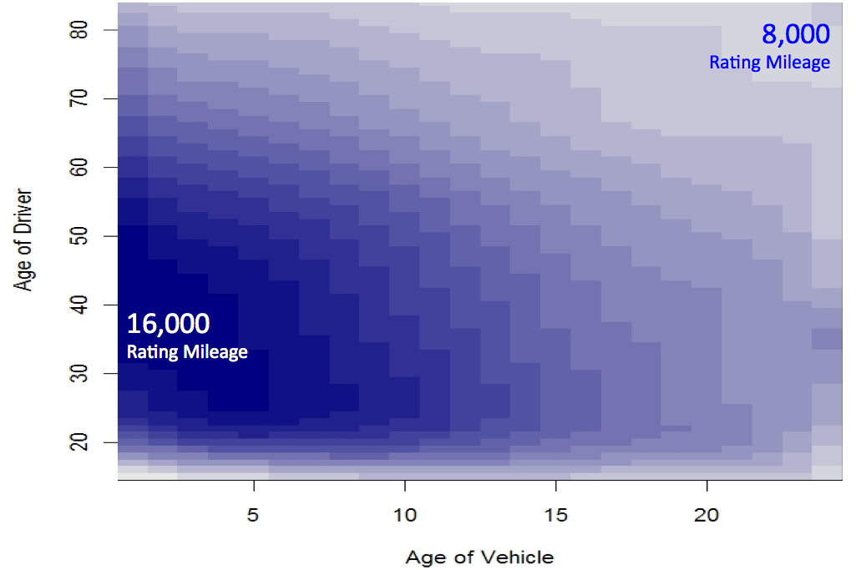
Rating Mileage Model
Results: 2D
Driver Age
Vehicle Age

Slide 10
Mileage Discount Analytics TM
To reduce double discounts risk use:
Example 1:
(new car and mid-age driver)
Example 2:
(older car or older driver)

Slide 11
Mileage Discount Analytics TM
Rating Mileage Table
Driver Age
Vehicle Age
State adjustments to the national rating mileage table also recommended and available.

Slide 12
Mileage Discount Analytics TM
Ryan N. Morrison
CEO | True Mileage, Inc.
Daniel Hernández-Stumpfhauser PhD
Lead Statistician | True Mileage, Inc.
Visit True Mileage at Booth #1
Insurance Telematics USA, Chicago, Sept 3-4, 2014
Notes:
True mileage overcomes the current issues by a combination of improved technology and analytics that make driving based rating viable for wide-spread on-going use.

